Slide 1
STAT2008/STAT6038
Deriving the Least Squares equations for SLR

Slide 2
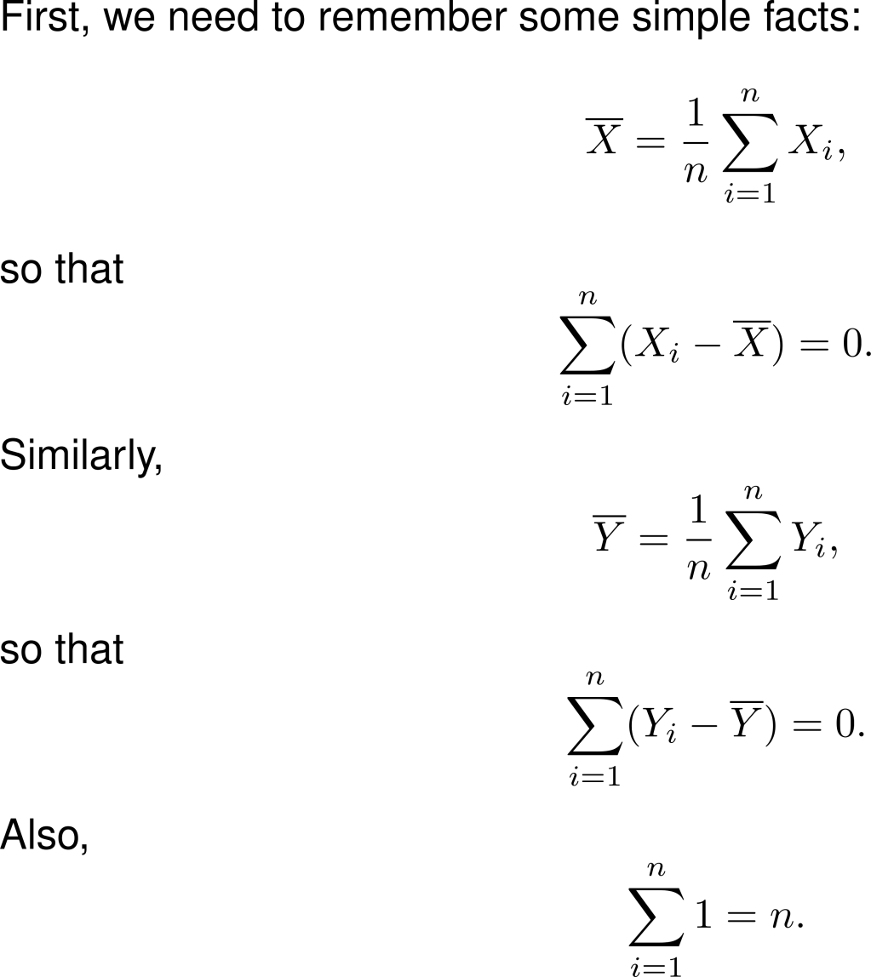

Slide 3
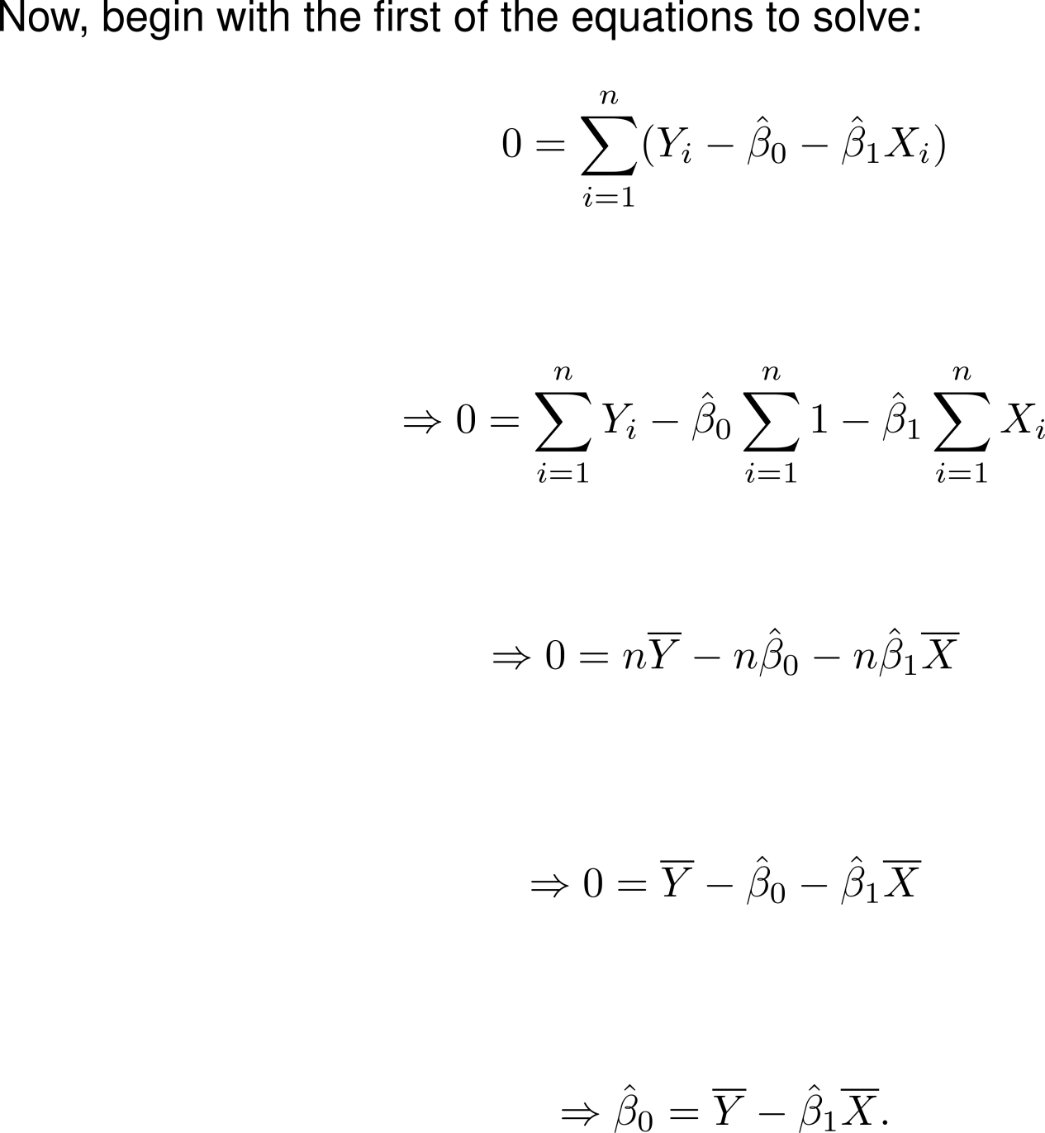

Slide 4
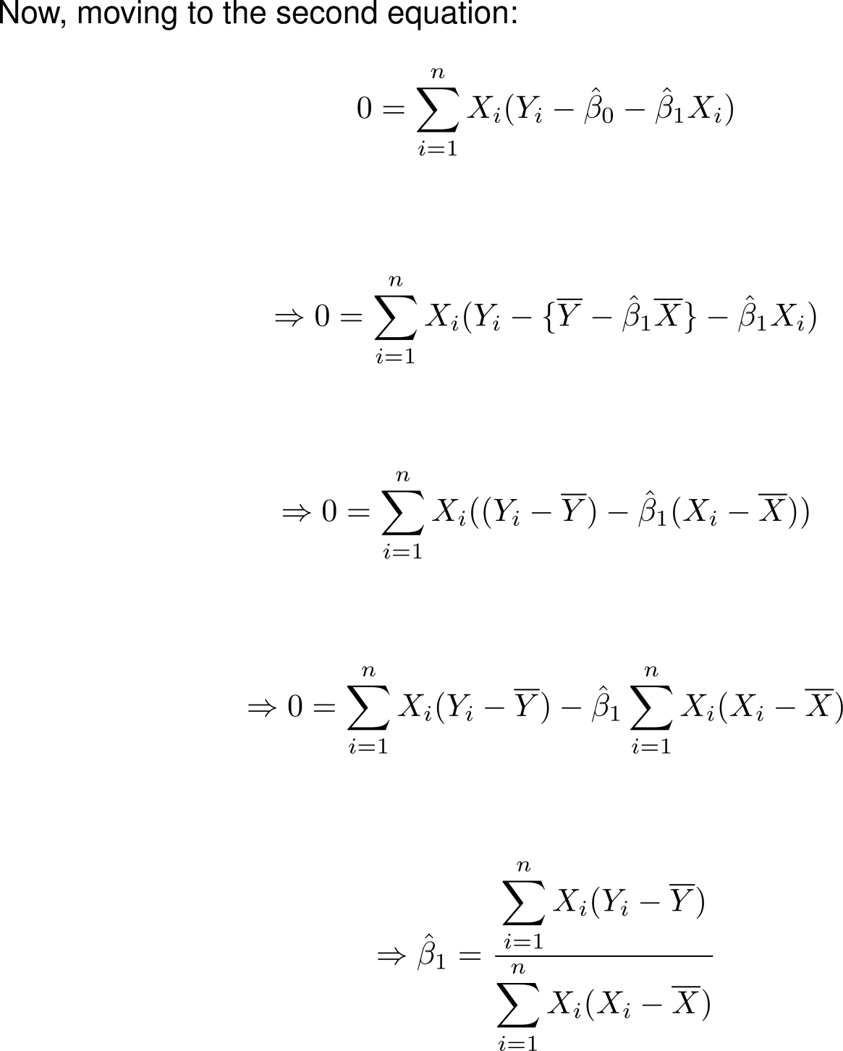

Slide 5
